Slide 1
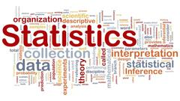
The Statistical Foundation of Artificial Intelligence
人工智能的统计基础
Rongling Wu (邬荣领)
Beijing Institute of Mathematical Sciences and Applications
Current Developments in Mathematics and Physics
2024数学与物理发展前沿国际会议

Slide 2
Artificial Intelligence (AI)
Is AI just a futuristic sci-fi trope?
No, it’s real, it’s here now, and it’s here to stay forever in science and society.
More importantly, it is revolutionizing the way we understand the world and change it.

Slide 3
The AI Is Taking Off
How to maximize its utility and minimize its harm?
Utility: Save many repetitive and mundane jobs and generate increased profits and more creative job opportunities.
Harm: Create misinformation, cyber warfare, amplified bias, and eventually massive system destruction.
To maximize its utility and minimize its harm, we need to know its fundamental and foundational core of how AI works.
It is statistics, whose role can be leveraged by mathematics.
Article writing: A ranked list of words drawn from the data set can generate reasonable continuations of text based on the probability theory.

Slide 4
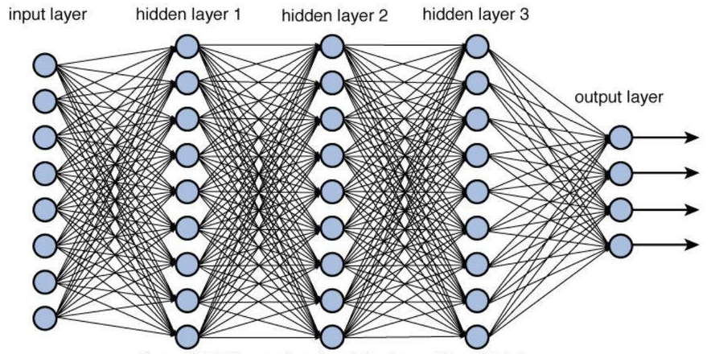
How AI Works?
AI is machine learning.
By inputting and processing data, AI can recognize behavior patterns and errors, in which it thinks, acts, and responds just like a real, live human.
At the core of ML are deep neural networks with multiple layers of interconnected nodes.
Each node relies on the data received from the previous layer to refine and optimize the prediction or categorization.
Data
Ingesting
Classification
Prediction
Statistics Statistics Statistics Statistics Statistics

Slide 5
Common Statistics Applied to AI
1 Probability theory
2 Regression models
3 Classification models
4 Clustering models
5 Graphical models
6 Deep learning models
7 Topological statistics and statistical topology

Slide 6
In my opinion, the statistic models currently applied in AI are too simple to capture the complexity of big data.
We have developed a library of advanced statistical models that can be used to improve the accuracy, precision, and power of AI.

Slide 7
No AI without Statistics:
No Advanced AI without Advanced Statistics
Great effort to develop advanced statistics underlying the foundational models powering AI interfaces.
The impact of statistics is increasingly recognized by many of the large language models (LLMs), such as OpenAI’s ChatGPT, Google’s Bard, Anthropic’s Claude, etc.

Slide 8
Common Statistics Applied to AI
1 Probability theory
2 Regression models
3 Classification models
4 Clustering models
5 Graphical models
6 Deep learning models
7 Topological statistics and statistical topology

Slide 9
1 Probability theory
Probability theory defines the concepts of random variables, events, outcomes, and distributions, and how to manipulate them using rules and theorems.
Probability theory is used to model and analyze uncertain data, to learn from limited samples, to make predictions, and to evaluate the performance of algorithms.
Probability theory can perform inference about complex systems using joint, conditional, and marginal probabilities based on Bayes' rule.
Prob(The genetic architecture of stemwood growth in forest trees | dataset trained) → Article
Vaswani, A., Shazeer, N., Parmar, N., Uszkoreit, J., Jones, L., Gomez, A. N., … & Polosukhin, I. (2017). Attention is all you need. Advances in neural information processing systems, 30

Slide 10
2 Regression models
Regression models are a type of statistical technique to find the relationship between a dependent variable and one or more independent variables.
Regression models can be used for prediction, estimation, or explanation of various phenomena.
For example, you can use regression models to predict the today’s weather based on the meteorological pattern of the previous days, to estimate the effect of a gene on human body height, or to explain how different factors influence human longevity.
The most common regression models are simple linear regression, multiple linear regression.

Slide 11
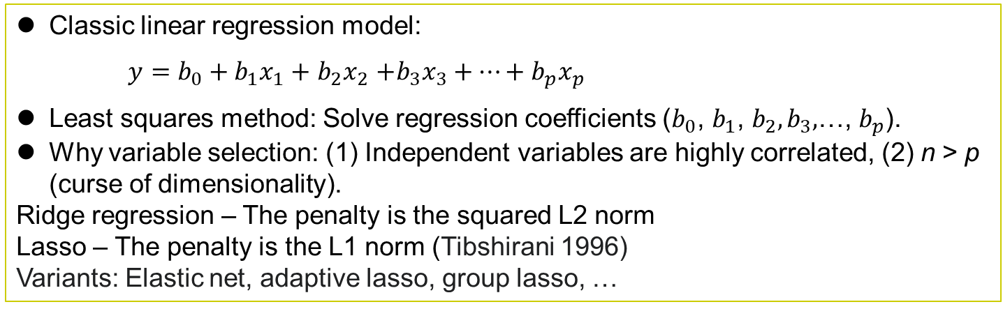
Data Structure
Sample Depend Independent Variables Subject
ID Var Var1 Var2 Var3 … Varp Index
1 y₁ x₁₁ x₂₁ x₃₁ … x_{p1} S₁
2 y₂ x₁₂ x₂₂ x₃₂ … x_{p2} S₂
3 y₃ x₁₃ x₂₃ x₃₃ … x_{p3} S₃
… … … … … … … …
n y_{n} x_{1n} x_{2n} x_{3n} … x_{pn} S_{n}
Variable V₀ V₁ V₂ V₃ … V_{p}
Index
Classic linear regression model:
$y=b_{0}+b_{1}x_{1}+$ $b_{2}x_{2}$ $+b_{3}x_{3}+…+b_{p}x_{p}$
Least squares method: Solve regression coefficients ($b_{0}$, $b_{1}$, $b_{2},b_{3},$…, $b_{p}$).
Why variable selection: (1) Independent variables are highly correlated, (2) n > p (curse of dimensionality).
Ridge regression – The penalty is the squared L2 norm
Lasso – The penalty is the L1 norm (Tibshirani 1996)
Variants: Elastic net, adaptive lasso, group lasso, …

Slide 12
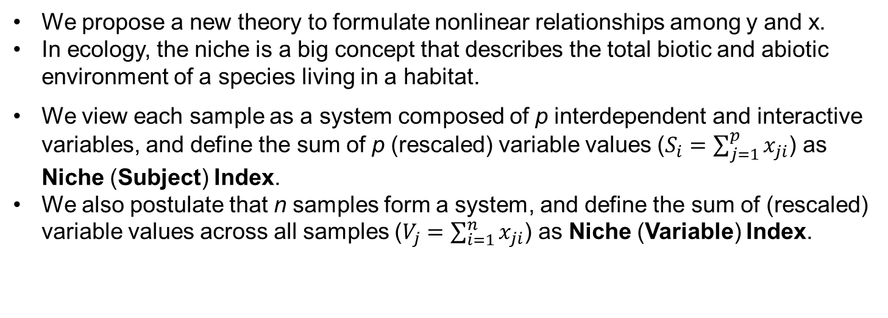
Nonlinear Regression: How to Perform Lasso
Sample Depend Independent Variables Subject
ID Var Var1 Var2 Var3 … Varp Index
1 y₁ x₁₁ x₂₁ x₃₁ … x_{p1} S₁
2 y₂ x₁₂ x₂₂ x₃₂ … x_{p2} S₂
3 y₃ x₁₃ x₂₃ x₃₃ … x_{p3} S₃
… … … … … … … …
n y_{n} x_{1n} x_{2n} x_{3n} … x_{pn} S_{n}
Variable V₀ V₁ V₂ V₃ … V_{p}
Index
We propose a new theory to formulate nonlinear relationships among y and x.
In ecology, the niche is a big concept that describes the total biotic and abiotic environment of a species living in a habitat.
We view each sample as a system composed of p interdependent and interactive variables, and define the sum of p (rescaled) variable values ($S_{i}=\sum_{j=1}^{p}{x_{ji}}$) as Niche (Subject) Index.
We also postulate that n samples form a system, and define the sum of (rescaled) variable values across all samples ($V_{j}=\sum_{i=1}^{n}{x_{ji}}$) as Niche (Variable) Index.

Slide 13
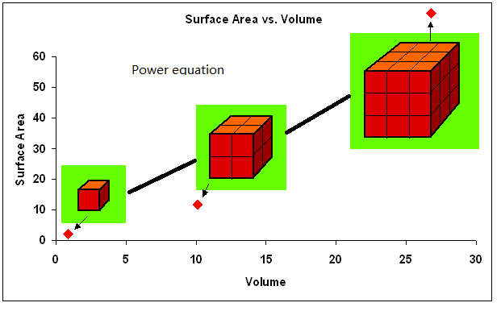
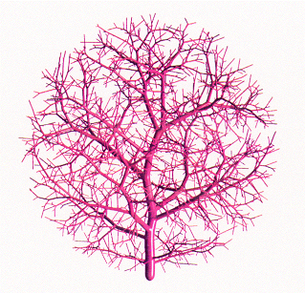
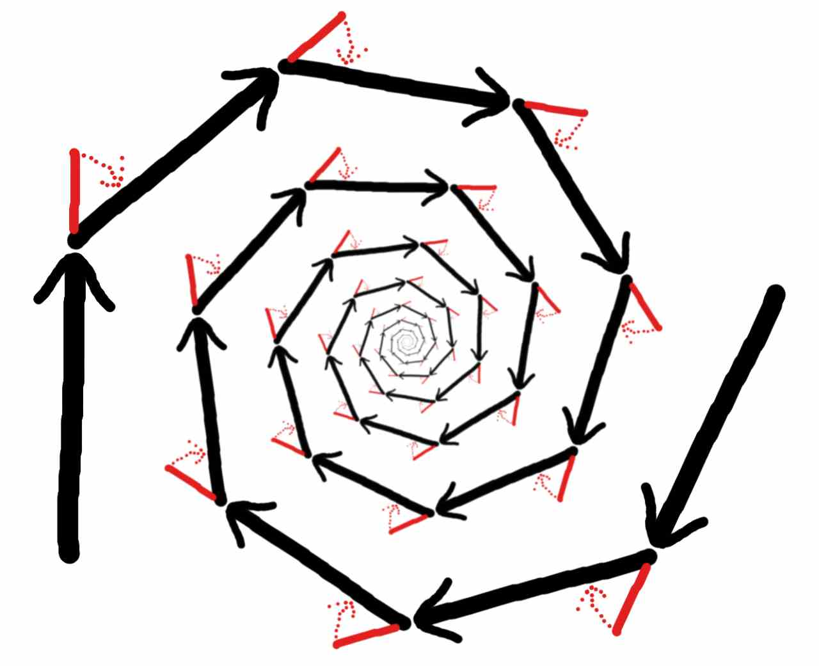
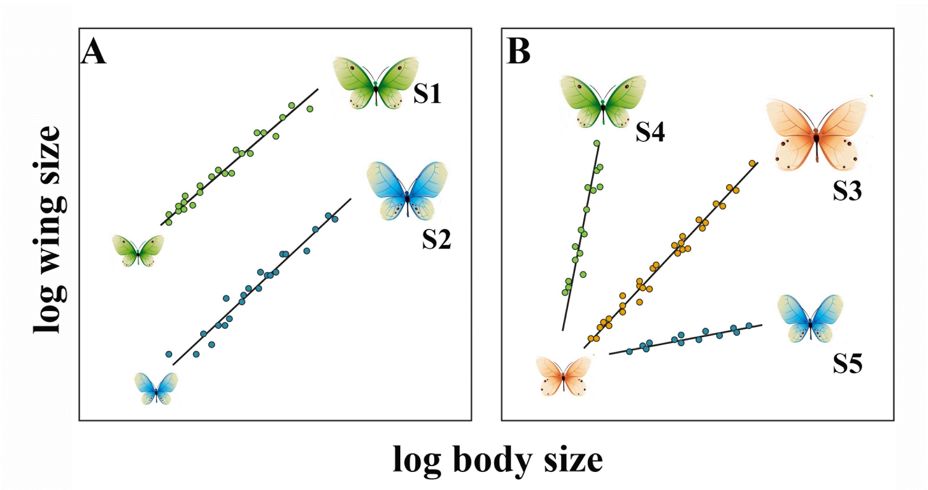
Physical Law: Allometric Scaling Law
The component-system relationship obeys the power scaling law.
Power equation:
y = αx^{β},
where α is the intercept and β is the slope.
Why is the power law is universal?
An explanation from the first principles
Wet Dry
An interdisciplinary collision (West, Brown and Enquist Science 1997,1999)

Slide 14
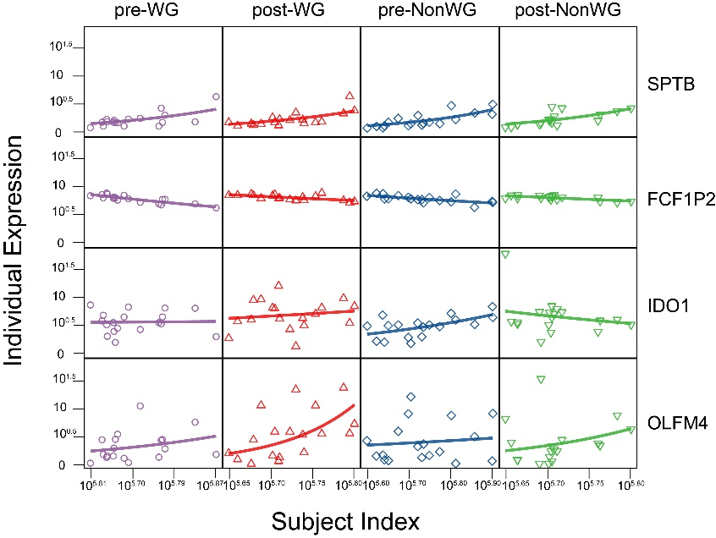
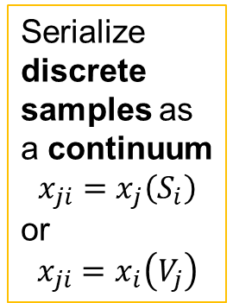
Power Fitting
Sample Depend Independent Variables Subject
ID Var Var1 Var2 Var3 … Varp Index
1 y₁ x₁₁ x₂₁ x₃₁ … x_{p1} S₁
2 y₂ x₁₂ x₂₂ x₃₂ … x_{p2} S₂
3 y₃ x₁₃ x₂₃ x₃₃ … x_{p3} S₃
… … … … … … … …
n y_{n} x_{1n} x_{2n} x_{3n} … x_{pn} S_{n}
Variable V₀ V₁ V₂ V₃ … V_{p}
Index
Serialize discrete samples as a continuum
$$x_{ji}=x_{j}\left(S_{i}\right)$$
or
$$x_{ji}=x_{i}\left(V_{j}\right)$$
Power equation:
Var = α (Subject Index)^β
Sample = α (Variable Index)^β
Crespo-Facorro et al. (2019). Altered gene expression in antipsychotic-induced weight gain. NPJ schizophrenia, 5(1), 7.
Gene expression change in response to body weight gain after drug treatment

Slide 15
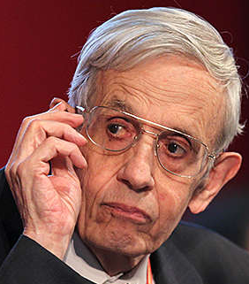
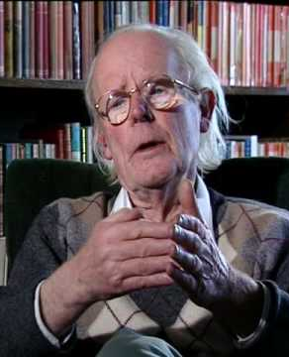
A Game-Theoretic Model of Nonlinear Regression
Game Theory The Nash equilibrium and a tit-for-tat strategy
The Nash equilibrium (Nash 1950, PNAS)
Evolutionarily stable strategy (ESS) (Smith and Price 1973, Nature)
For an evolving system, this game will occur repeatedly:
Left Right Niche Index
C C N₁
C C N₂
F F N₃
C C N₄
C F N₅
C C N₆
C C N₇
C F N₈
C C N₉
F F N₁₀
C C N₁₁
C C N₁₂
C C N₁₃
C Retreat N₁₄
x y
The payoff of one cat (player) is determined by
its own strategy and the strategy of the other cat
dx/dN = Q₁(x(N)) + Q_{1←2}(y(N)) dy/dN = Q₂(y(N)) + Q_{2←1}(x(N))
Independent Dependent
self-regulation external regulation
A cat decides to cooperate or fight off the other cat per game theory.
The ODE with the time derivative replaced by the niche index derivative (called quasi-dynamic mixed ODE)

Slide 16
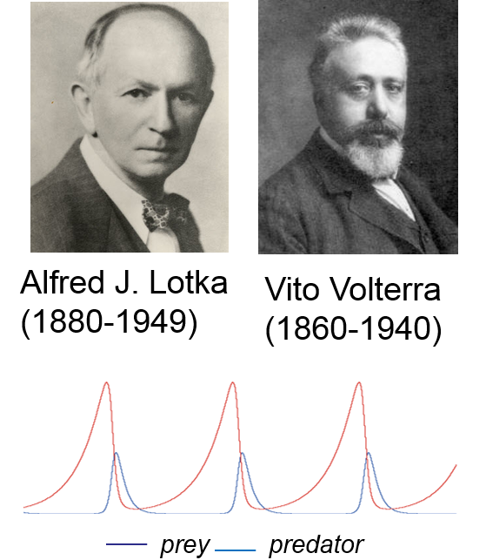
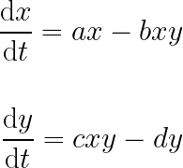
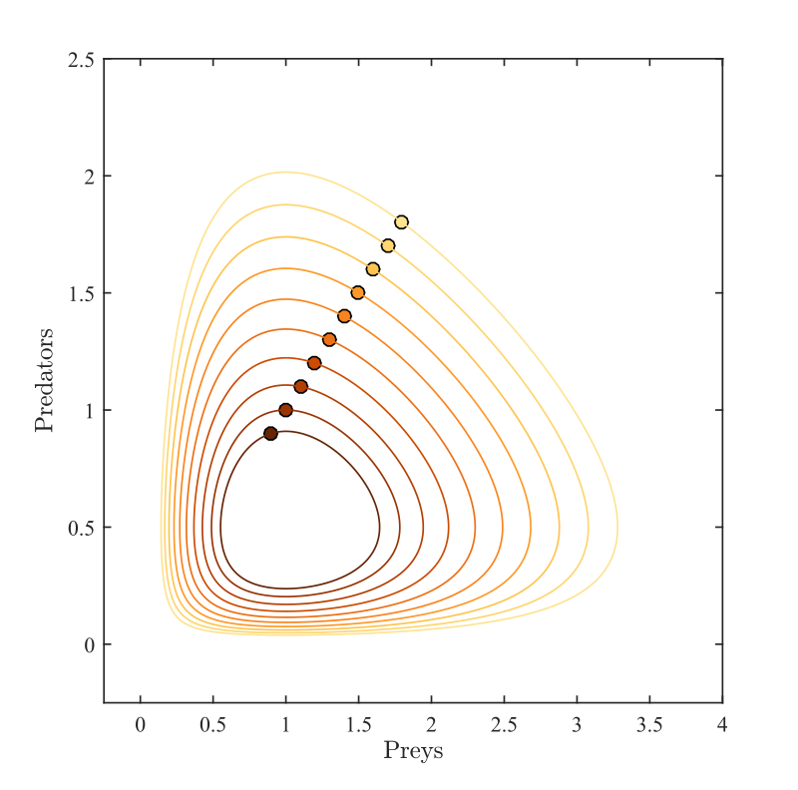
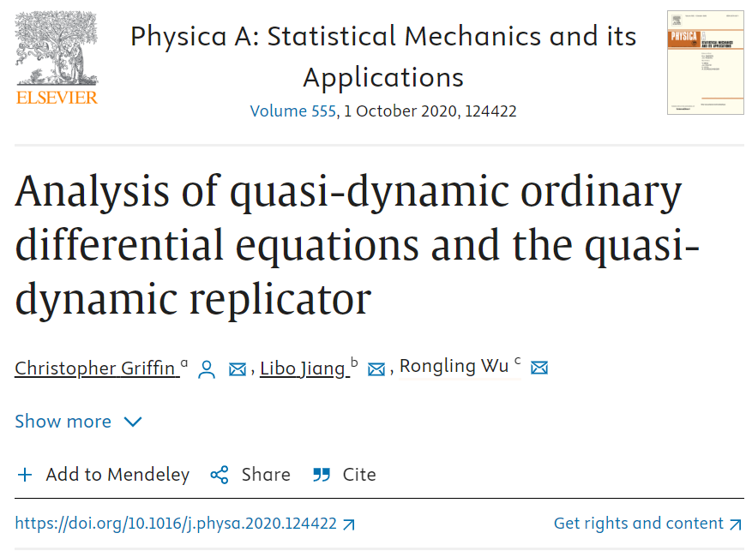

Quasi-dynamic Replicator:
A generalized Lotka-Volterra (LV) equation
LV equation Our equation
dx/dN = Q₁(x(N)) + Q_{1←2}(y(N)) dy/dN = Q₂(y(N)) + Q_{2←1}(x(N))
Chris Griffin
We prove asymptotic properties of these systems and show that there exist populations for which the proportion of the population varies cyclically as a function of total logarithmic population size.
Phase-space plot

Slide 17
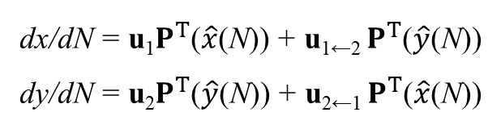
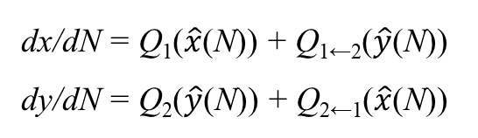
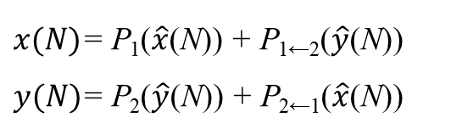
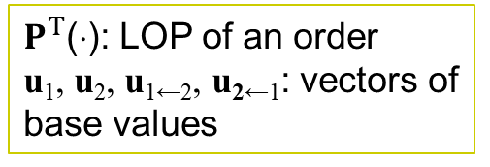
Fitting Quasi-dynamic Mixed ODE
by Nonparametric Legendre Orthogonal Polynomials
Unknown nonlinear forms
dx/dN = Q₁(x(N)) + Q_{1←2}(y(N))
dy/dN = Q₂(y(N)) + Q_{2←1}(x(N))
Nonlinear
Nonlinear
Linear
Linear
Power fitting
dx/dN = Q₁($\hat{x}$(N)) + Q_{1←2}($\hat{y}$(N))
dy/dN = Q₂($\hat{y}$(N)) + Q_{2←1}($\hat{x}$(N))
LOP transformation
dx/dN = u₁$P^{T}$($\hat{x}$(N)) + u_{1←2} $P^{T}$($\hat{y}$(N))
dy/dN = u₂$P^{T}$($\hat{y}$(N)) + u_{2←1} $P^{T}$($\hat{x}$(N))
$P^{T}$(⋅): LOP of an order
u₁, u₂, u_{1←2}, u_{2←1}: vectors of base values
Integral
$x(N)$= P₁($\hat{x}$(N)) + P_{1←2}($\hat{y}$(N))
$y(N)$= P₂($\hat{y}$(N)) + P_{2←1}($\hat{x}$(N))
Transformed to be a linear regression model

Slide 18
A Multiple Linear Regression Form
of Nonlinear Dynamic Systems
Sample Depend Independent Variables Subject
ID Var Var1 Var2 Var3 … Varp Index
1 y₁ x₁₁ x₂₁ x₃₁ … x_{p1} S₁
2 y₂ x₁₂ x₂₂ x₃₂ … x_{p2} S₂
3 y₃ x₁₃ x₂₃ x₃₃ … x_{p3} S₃
… … … … … … … …
n y_{n} x_{1n} x_{2n} x_{3n} … x_{pn} S_{n}
V. index V₀ V₁ V₂ V₃ … V_{p}
Multiple linear regression model:
Least squares method: Solve regression coefficients (u_{y}, u_{y←x1}, u_{y←x2}, …).
Variable selection by Lasso – The penalty is the L1 norm (Tibshirani 1996)
Select a small subset of the most significant predictors that link with the dependent variable
Statistical breakthrough:
Overcome the issue of p >> n for nonlinear complex systems.
y$(N)$= P_{y}($\hat{y}$(N)) +$\text{P}\text{y}\text{←}\text{x}\text{1(}{\hat{x}}_{1}\text{(}\text{N}\text{))}$ + $\text{P}\text{y}\text{←}x2\text{(}{\hat{x}}_{2}\text{(}\text{N}\text{))}$ + … + $\text{P}\text{y}\text{←}xp\text{(}{\hat{x}}_{p}\text{(}\text{N}\text{))}$

Slide 19
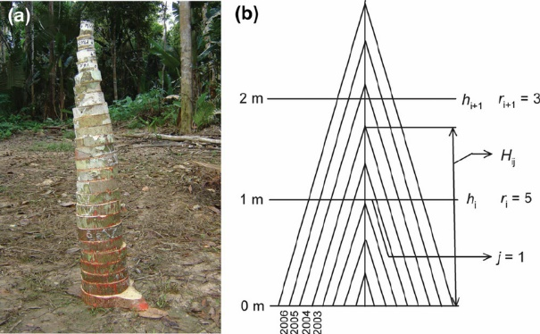
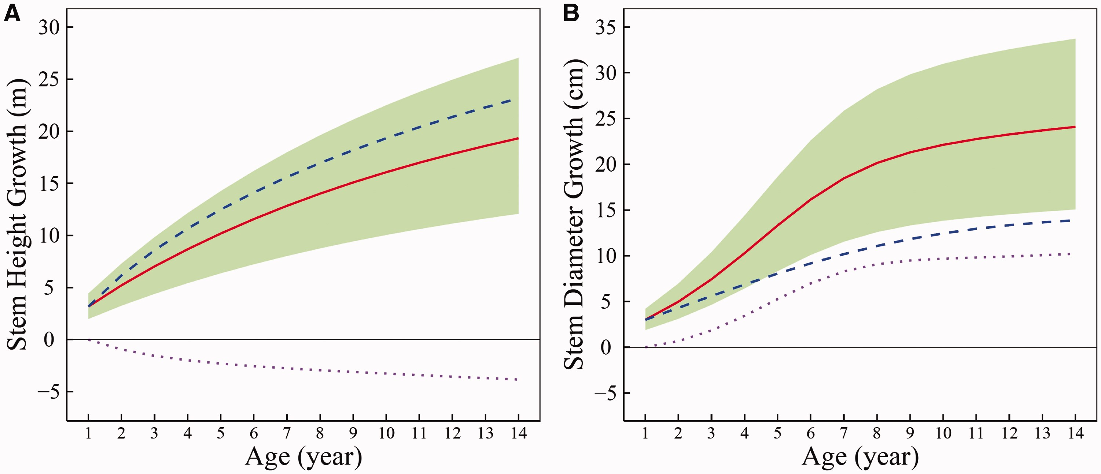
Comparison
Traditional Linear Model Quasi-dynamic Nonlinear Model
1 Linearity Nonlinearity (omnipresent)
2 Discrete samples Continuous niche index (predictability)
3 Linear computation Linear computation
4 Phenomenological observation Mechanistic exploration
5 Statistical significance First Principle (physical law)
Independent curve
Observed curve
Dependent curve
The nonlinear relationship between stem height growth and stem diameter growth
Stem diameter growth inhibits stem height growth
Stem height growth promotes stem diameter growth

Slide 20
3 Classification models
Classification models are a type of supervised learning technique that aim to assign a label or a category to an input based on some features.
Classification models can be used for identification, recognition, or diagnosis of various objects or situations.
For example, you can use classification models to identify the species of a flower based on its petals, to recognize the face of a person based on their image, or to diagnose a disease based on the symptoms.
Some common classification models are decision trees, k-nearest neighbors, support vector machines, and neural networks.

Slide 21
4 Clustering models
Clustering models aim to group similar variables together based on their similarity or distance.
Clustering models can discover the hidden structure or patterns in a data set, to segment the patients based on their genetic and clinical information, or to simplify the data by reducing its dimensionality.
Some common clustering models are k-means, hierarchical clustering, and Gaussian mixture models.
These models are limited:
When the dimension of variables is high (usually very high or ultrahigh for big datasets;
Because no mechanistic principle is implemented.
We propose a powerful tool for variable clustering by implementing the power law.

Slide 22
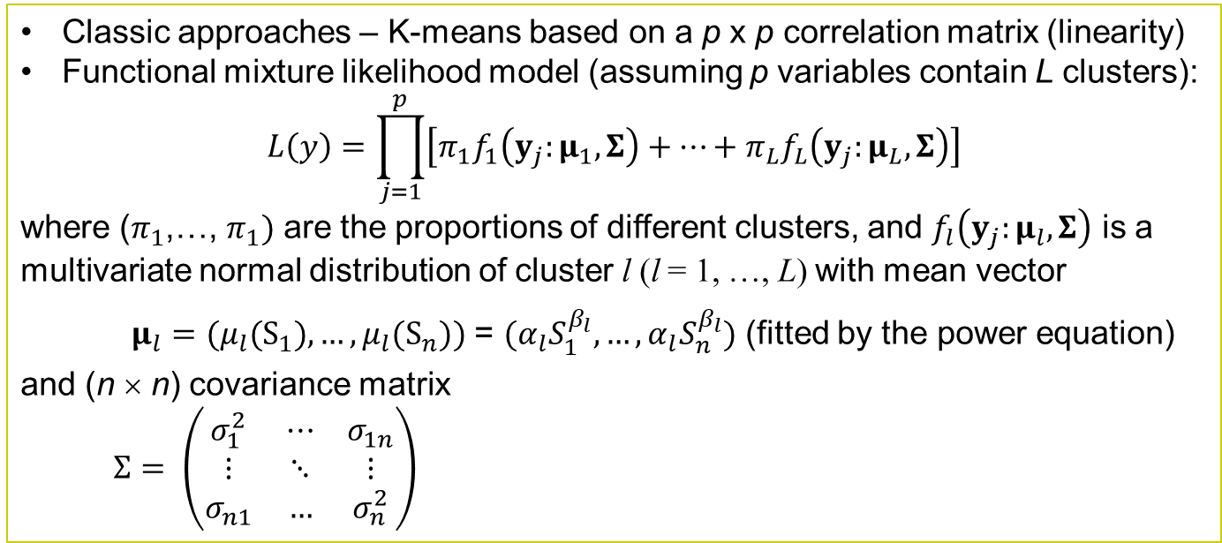
Functional Clustering
ID Var1 Var2 Var3 Var4 … Varp S.Index
1 y₁₁ y₂₁ y₃₁ y₄₁ … y_{p1} S₁
2 y₁₂ y₂₂ y₃₂ y₄₂ … y_{p2} S₂
… … … … … … … …
n y_{1n} y_{2n} y_{3n} y_{4n} … y_{pn} S_{n}
V.Index V₁ V₂ V₃ V₄ … V_{p}
Classic approaches – K-means based on a p x p correlation matrix (linearity)
Functional mixture likelihood model (assuming p variables contain L clusters):
$$L\left(y\right)=\prod_{j=1}^{p}{\left[π_{1}f_{1}\left(y_{j}:μ_{1},Σ\right)+…+π_{L}f_{L}\left(y_{j}:μ_{L},Σ\right)\right]}$$
where ($π_{1}$,…, $π_{1})$ are the proportions of different clusters, and $f_{l}\left(y_{j}:μ_{l},Σ\right)$ is a multivariate normal distribution of cluster l (l = 1, …, L) with mean vector
$μ_{l}=(μ_{l}(S_{1}),…,μ_{l}(S_{n}))$ = $(α_{l}S_{1}^{β_{l}}, …,α_{l}S_{n}^{β_{l}})$ (fitted by the power equation)
and (n × n) covariance matrix
$Σ= \left(\begin{matrix}σ_{1}^{2} & ⋯ & σ_{1n} \\ ⋮ & ⋱ & ⋮ \\ σ_{n1} & … & σ_{n}^{2}\end{matrix}\right)$
(fitted by the first-order structured antedependence model (Zhao et al. 2005 et al., Bioinformatics)

Slide 23
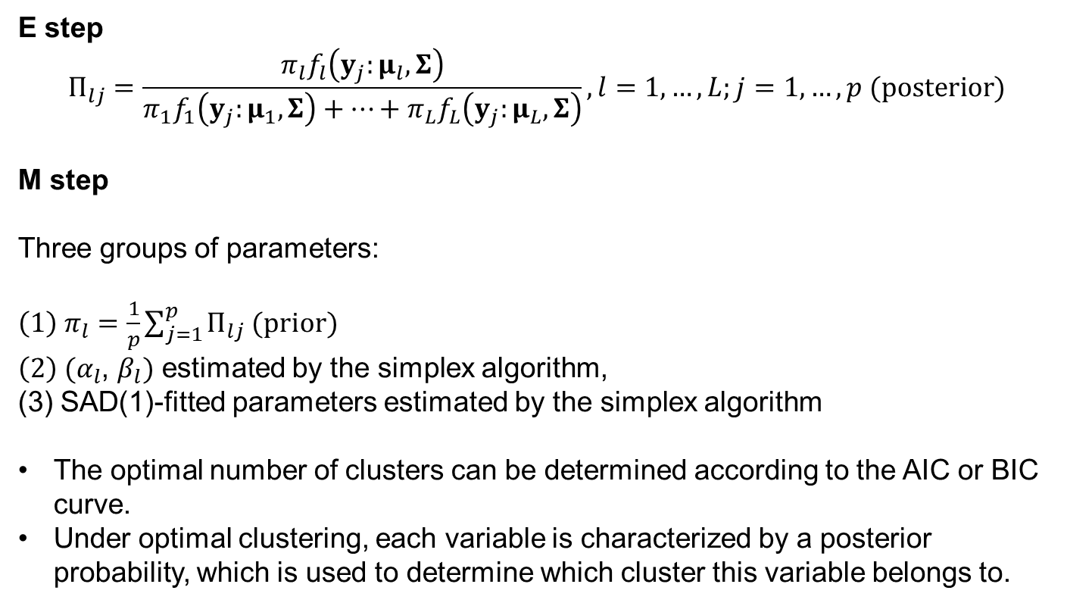
A Hybrid of the EM Algorithm
Implemented with the Simplex Algorithm
E step
$$Π_{lj}=\frac{π_{l}f_{l}\left(y_{j}:μ_{l},Σ\right)}{π_{1}f_{1}\left(y_{j}:μ_{1},Σ\right)+…+π_{L}f_{L}\left(y_{j}:μ_{L},Σ\right)}, l=1,…, L;j=1, …, p (posterior)$$
M step
Three groups of parameters:
${\left(1\right) π}_{l}=\frac{1}{p}\sum_{j=1}^{p}{Π_{lj}}$ (prior)
$\left(2\right) (α_{l}$, $β_{l})$ estimated by the simplex algorithm,
(3) SAD(1)-fitted parameters estimated by the simplex algorithm
The optimal number of clusters can be determined according to the AIC or BIC curve.
Under optimal clustering, each variable is characterized by a posterior probability, which is used to determine which cluster this variable belongs to.
Kim BR, Zhang L, Berg A, Fan J, Wu R. A computational approach to the functional clustering of periodic gene-expression profiles. Genetics. 2008 Oct;180(2):821-34.

Slide 24
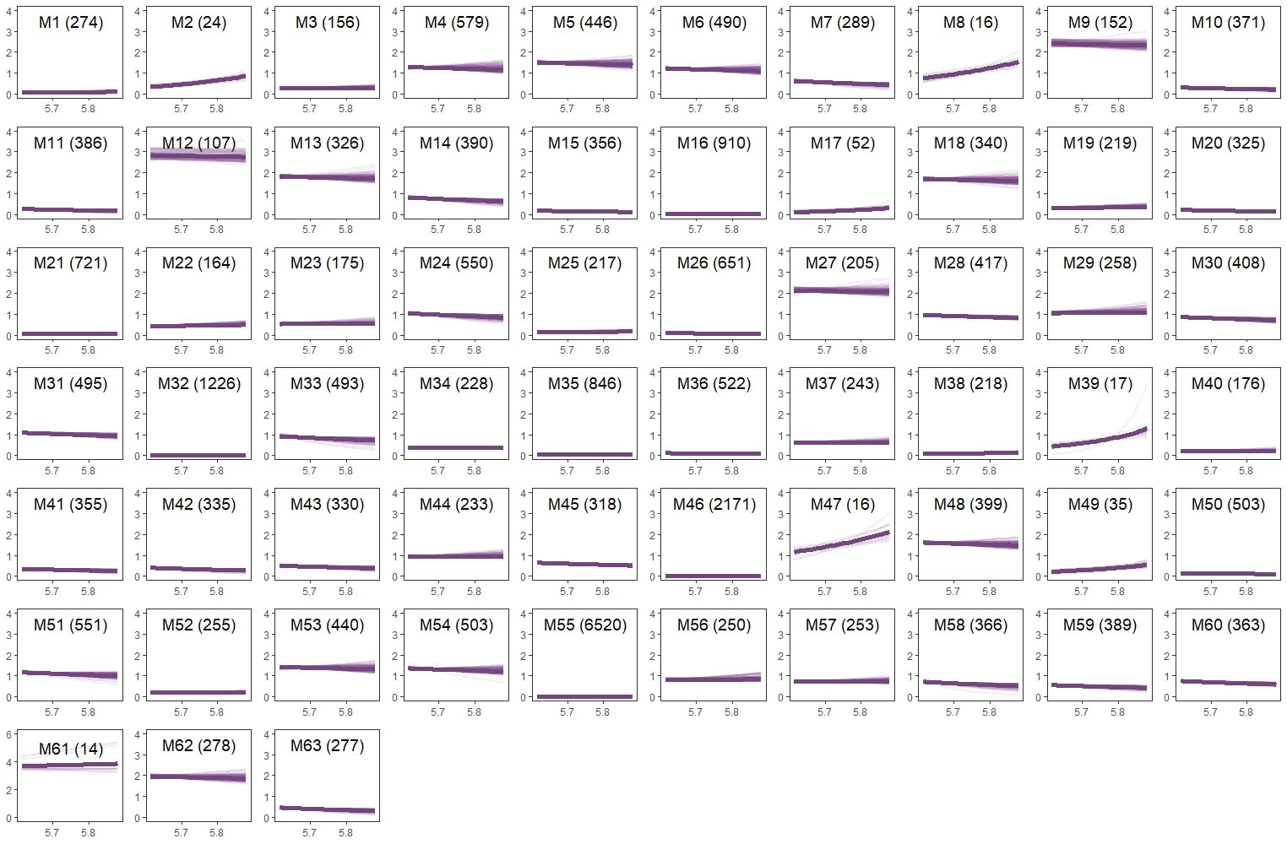
Example

Slide 25
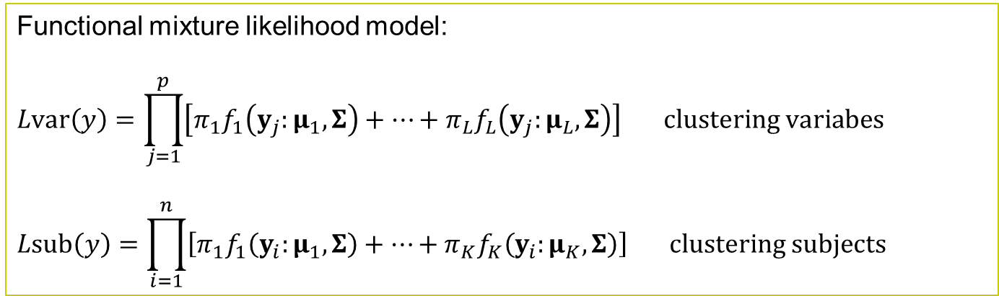
Functional Clustering
ID Var1 Var2 Var3 Var4 … Varp S.Index
1 y₁₁ y₂₁ y₃₁ y₄₁ … y_{p1} S₁
2 y₁₂ y₂₂ y₃₂ y₄₂ … y_{p2} S₂
… … … … … … … …
n y_{1n} y_{2n} y_{3n} y_{4n} … y_{pn} S_{n}
V.Index V₁ V₂ V₃ V₄ … V_{p}
Functional mixture likelihood model:
$$Lvar\left(y\right)=\prod_{j=1}^{p}{\left[π_{1}f_{1}\left(y_{j}:μ_{1},Σ\right)+…+π_{L}f_{L}\left(y_{j}:μ_{L},Σ\right)\right] clustering variabes}$$
$$Lsub\left(y\right)=\prod_{i=1}^{n}{\left[π_{1}f_{1}\left(y_{i}:μ_{1},Σ\right)+…+π_{K}f_{K}\left(y_{i}:μ_{K},Σ\right)\right] clustering subjects}$$
In medical research, classifying subjects into distinct groups based on their similarity of variable variability pattern is of great importance for designing precise medicine.

Slide 26
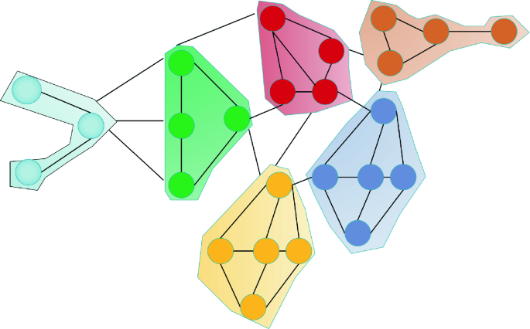
Comparison
K-means Functional Clustering
1 Linearity Nonlinearity (omnipresent)
2 Correlation/distance Functional pattern
3 Phenomenological observation Mechanistic exploration
4 Statistical significance First Principle (physical law)
Functional clustering also plays a role in graph theory
Subnetwork community detection
A top-down approach: dividing the network into smaller subnetworks (Viles and O’Malley 2023)
A bottom-up approach: clustering nodes into multiple subsets each forming a subnetwork
Viles WD, O’Malley AJ (2023) Constrained Community Detection in Social Networks, N Engl J STAT DATA SCI, 1-12,

Slide 27
5 Graphical models
Aim to represent the dependencies and independencies among a set of random variables using graphs.
Characterize the causal relationships among the variables in a domain, infer the values of some variables given the values of others, or learn the structure and parameters of the model from data.
Directed or undirected, depending on the direction of the edges.
Some common graphical models are Bayesian networks, Markov networks, hidden Markov models, and conditional random fields.
These models are limited:
Can only detect part of interaction properties, failing to capture a full set of bi-directionality, sign, and weight.
Fail to reconstruct large-scale networks from high-dimensional data.
Can only reconstruct an overall network from a large population of samples, unable to characterize individualized or context-specific networks
No general framework is available to characterize high-order interactions across different data domains and scenarios.

Slide 28
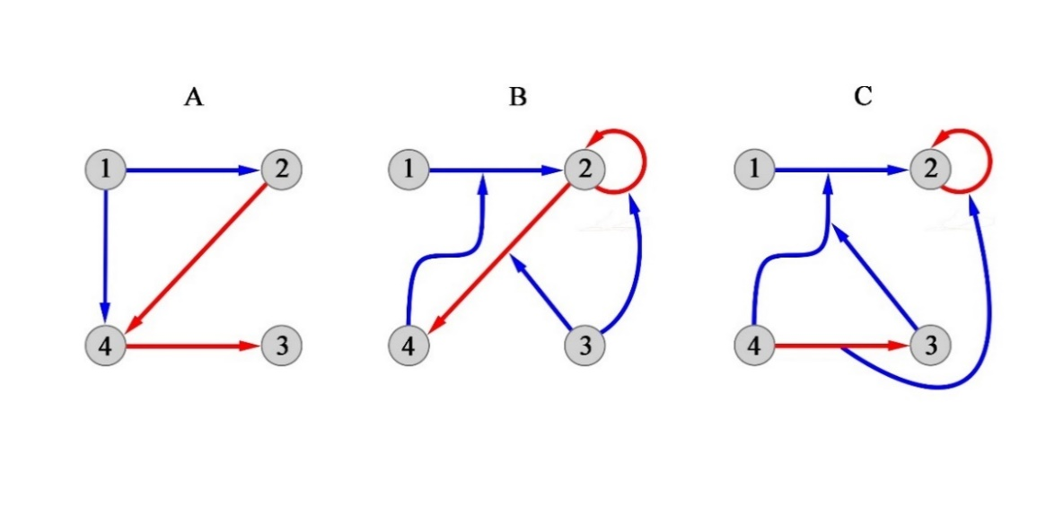
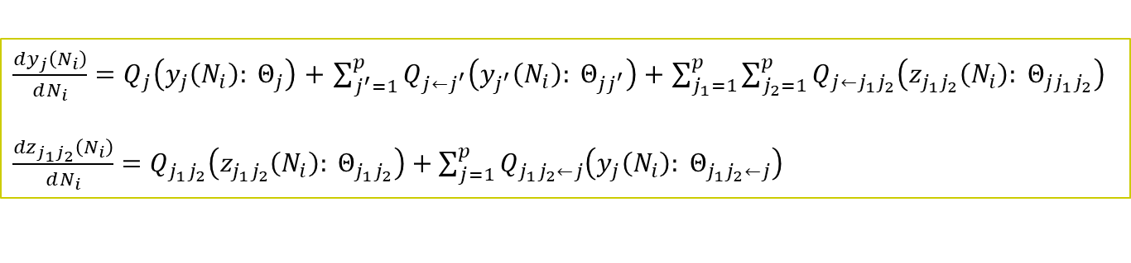
The Extension of Quasi-dynamic Mixed ODE
ID Var1 Var2 Var3 Var4 … Varp S.Index
1 y₁₁ y₂₁ y₃₁ y₄₁ … y_{p1} S₁
2 y₁₂ y₂₂ y₃₂ y₄₂ … y_{p2} S₂
… … … … … … … …
n y_{1n} y_{2n} y_{3n} y_{4n} … y_{pn} S_{n}
V.Index V₁ V₂ V₃ V₄ … V_{p}
Consider a large complex system composed of p components
$\frac{dy_{j}\left(N_{i}\right)}{dN_{i}}=Q_{j}\left(y_{j}\left(N_{i}\right): Θ_{j}\right)$ $+$ $\sum_{j^{′}=1}^{p}{Q_{j←j^{′}}\left(y_{j^{′}}\left(N_{i}\right): Θ_{jj^{′}}\right)}+$ $\sum_{j_{1}=1}^{p}{\sum_{j_{2}=1}^{p}{Q_{j←j_{1}j_{2}}\left(z_{j_{1}j_{2}}\left(N_{i}\right): Θ_{jj_{1}j_{2}}\right)}}$
$\frac{{dz}_{j_{1}j_{2}}\left(N_{i}\right)}{dN_{i}}=$ $Q_{j_{1}j_{2}}\left(z_{j_{1}j_{2}}\left(N_{i}\right): Θ_{j_{1}j_{2}}\right)+\sum_{j=1}^{p}{Q_{j_{1}j_{2}←j}\left(y_{j}\left(N_{i}\right): Θ_{j_{1}j_{2}←j}\right)}$
High-order networks include
how a pairwise interaction actively affects a node (phylum)
how a dyadic interaction is passively affected by a node
Pairwise interaction is defined by z_{j1j2}
passive
active
Hypernetworks

Slide 29
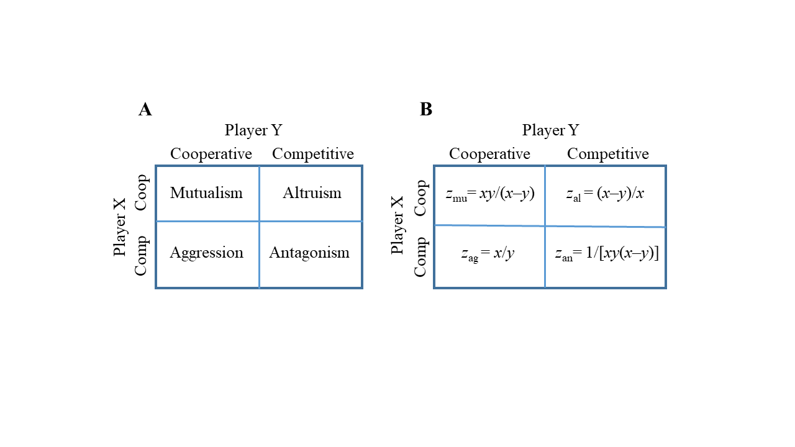
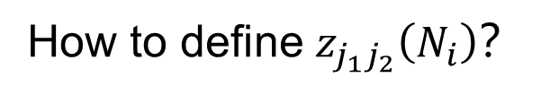
A quantitative decision theory of animal conflict
(Wu and Jiang et al. 2021, Heliyon 7(7): e07621)
How to define $z_{j_{1}j_{2}}\left(N_{i}\right)$？
Mutualism-based hypernetworks, z_{mu}
Altruism-based hypernetworks, z_{al}
Aggression-based hypernetworks, z_{ag}
Antagonism-based hypernetworks, z_{an}
Experiemntal validation by Jiang et al. 2019, 2020; Wang et al. 2019, He et al. 2021

Slide 30
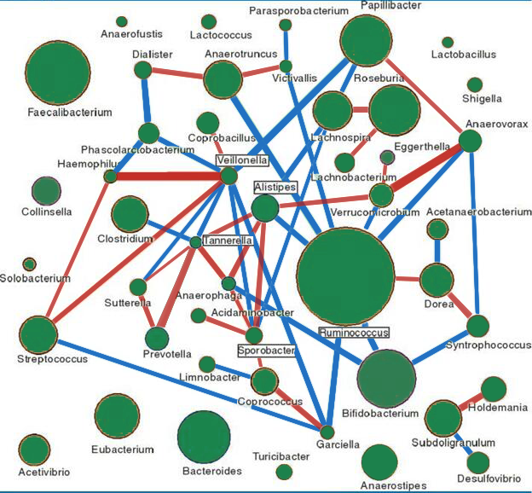
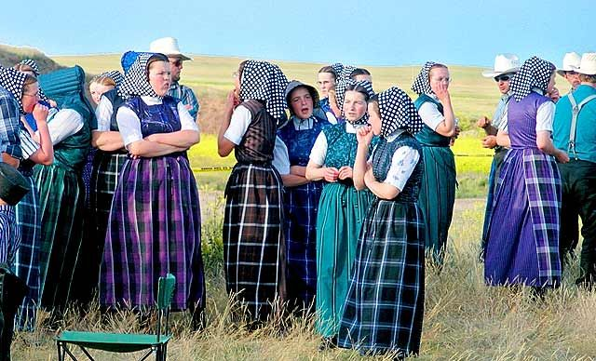
Data Modeling of Hypernetworks
A Preliminary Result
The Gut Microbiota
Davenport et al.’s (2015) data
Include 184 Amish samples from a founder, the Hutterites
Measured at phylum, class, order, family, genus, and species levels in the winter and the coming summer.

Slide 31
Active Hypernetworks (mutualism)
active
active

Slide 32
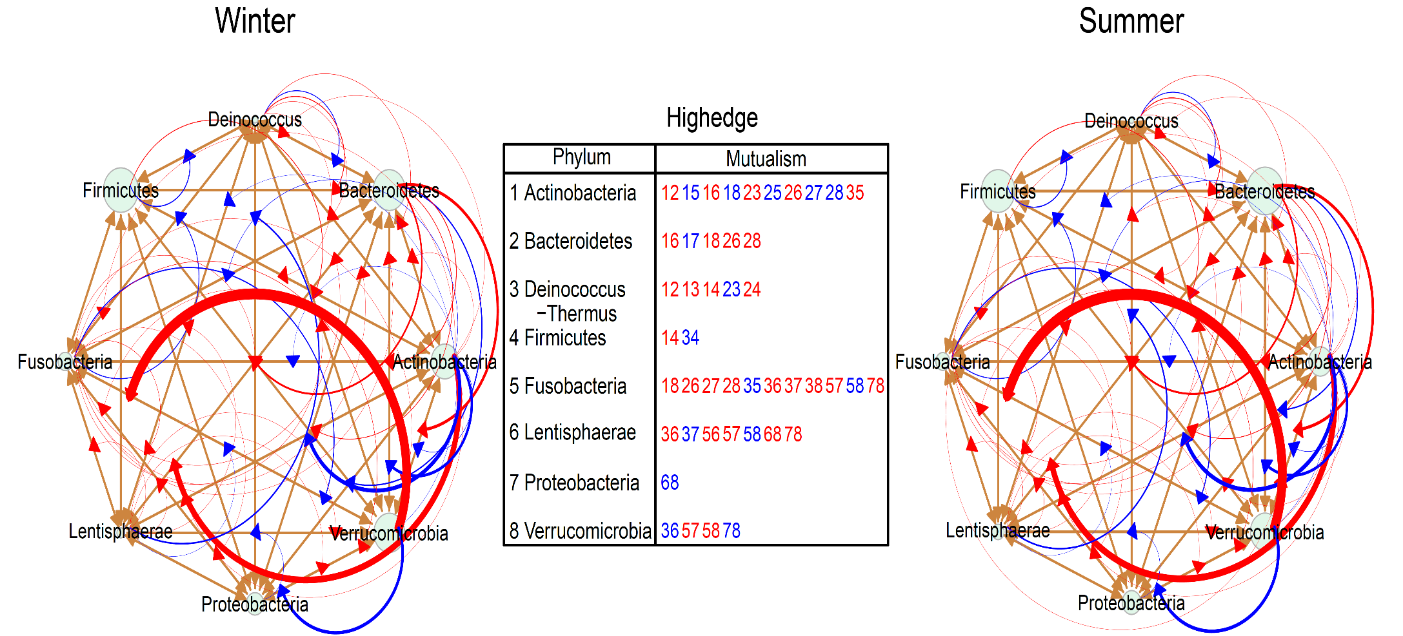
Passive Hypernetworks (mutualism)
passive

Slide 33
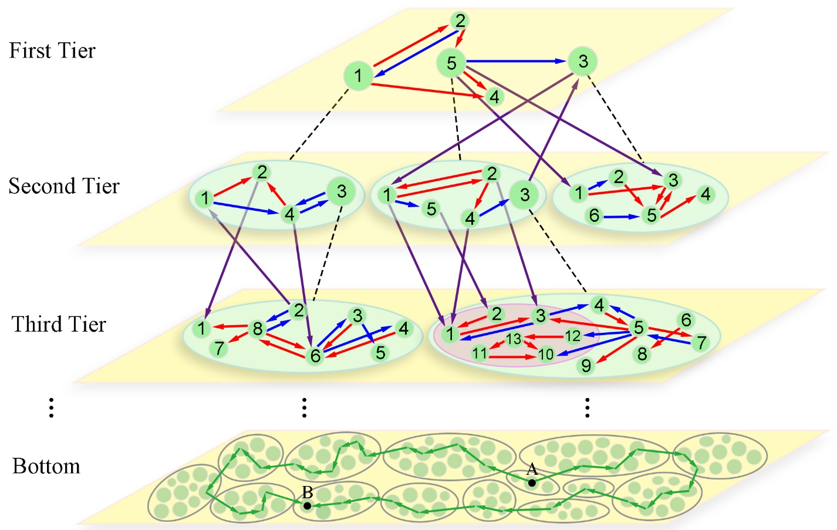
A multilayer, multiplex, and multifunctional network
from any number of elements
Informative
- Causal
- Stable
- Sparse
Dynamic
Omnidirectional
Personalized
idopNetwork
idopNetwork has proved its power to dissect the internal workings of complex systems, such as the gut microbiota (Cao et al. 2021), the vaginal microbiota (Wang et al. 2022), cancer genomics (Sun et al. 2021), tumor-microenvironment interactions (Sang et al. 2023), and combinational therapies (Sang et al. 2022).

Slide 34
6 Deep learning models
A type of neural network model that consist of multiple layers of nonlinear transformations that can learn from large and complex data sets.
Deep learning models can be used for various tasks that require high-level abstraction, representation, or generation of data.
For example, you can use deep learning models to perform image recognition, natural language processing, speech synthesis, or generative adversarial networks.
Deep learning models can be feedforward or recurrent, depending on the flow of information in the network.
Some common deep learning models are convolutional neural networks, recurrent neural networks, long short-term memory, and transformers.

Slide 35

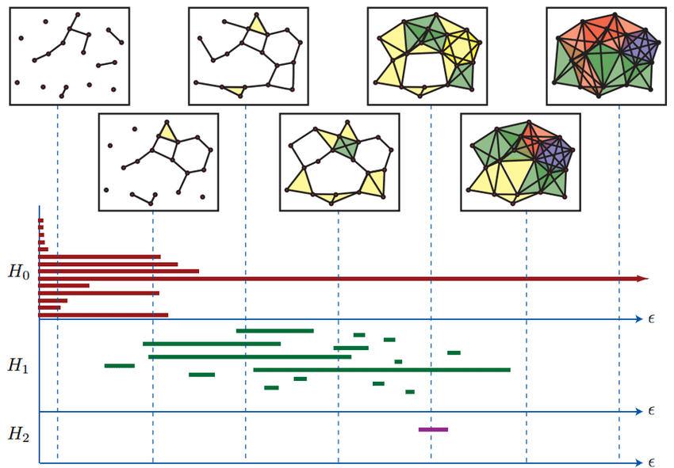
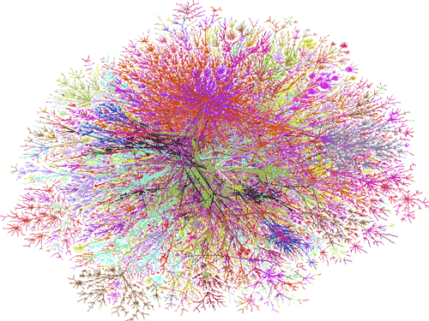
7. Topological statistics and statistical topology
Statistics is a technique of data analysis and modeling
Topology studies the pattern of connectivity or spatial sequence of elements in a structure.
Statistics is crossed over with topology to study the geometry of big data.
The rank of the homology groups of dimension 0, 1, and 2 associated with a sequence of nested sub-complexes.

Slide 36
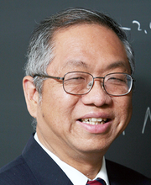

A powerful too for complex systems:
idopNetwork meets GLMY homology theory
Grigor'yan A, Lin Y, Muranov Y, Yau S-T (2020) Path complexes and their homologies. J Math Sci 248: 564-599. GLMY homology theory
Jie Wu: A top topologist

Slide 37
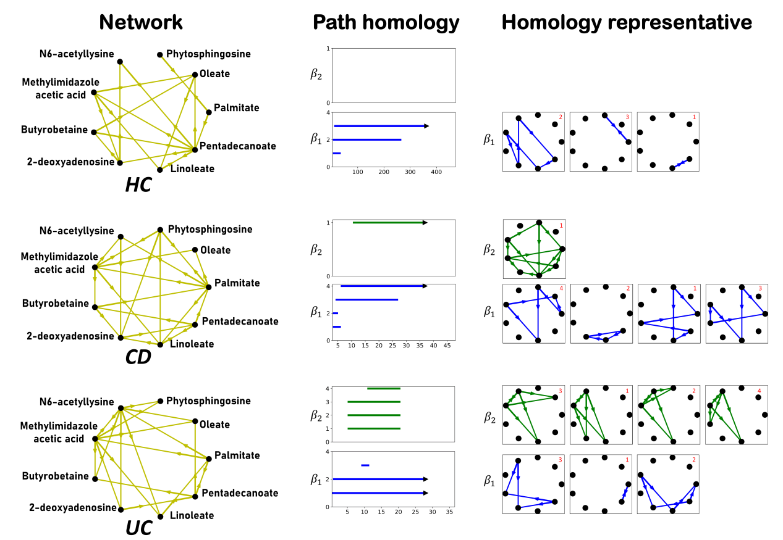
Example:
Metabolic Topology of Ulcerative Colitis (UC) and Crohn’s Disease (CD)
1- and 2-dimensional Homology

Slide 38
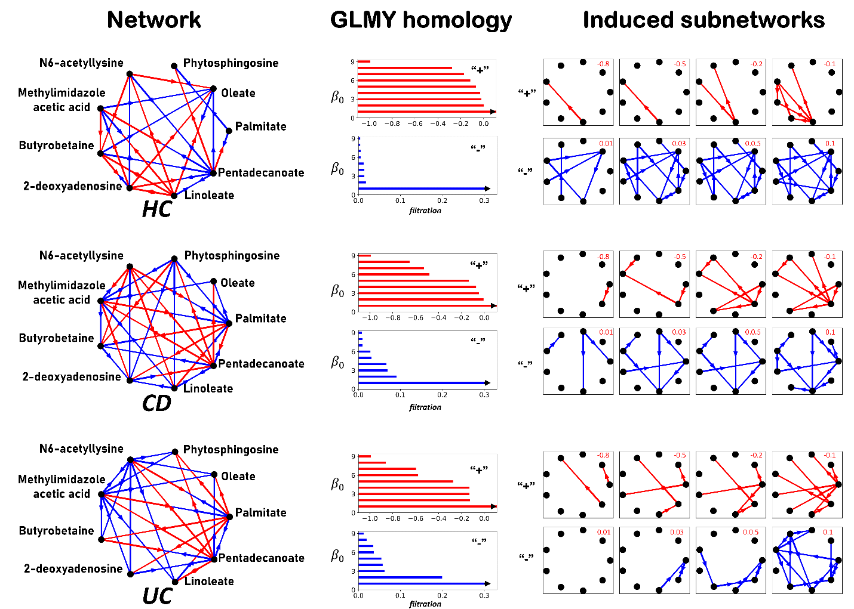
0-dimensional Homology

Slide 39
Detecting the topological pathway
of inflammatory form
HC Acetyllysine (乙酰亮氨酸) MAA
UC
Phytospingosine (植物鞘氨醇) CD
Linoleate (亚油酸盐)
Methylimidazole acetic acid (甲基咪唑乙酸)
Histamine ( (组胺)
Inflammatory Bowel Disease
Current drugs are histamine-designed, which can inhibit IBD, cannot eradicate it.
Inhibition

Slide 40
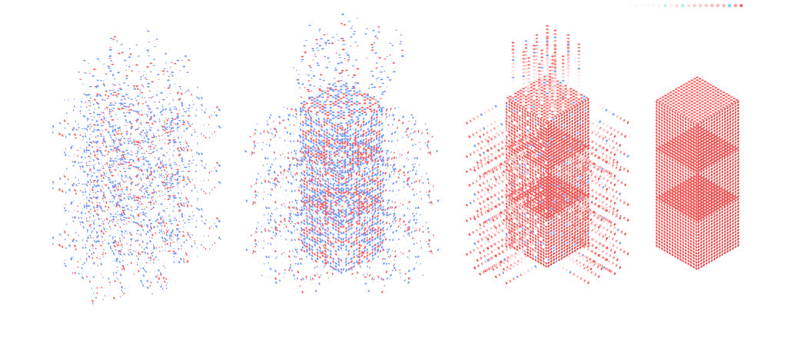
Topological Statistics
Data Phenomenon Mechanism Mechanism
ANOVA Supervised
Mixture models
Top Stat
How to characterize variation and uncertainty in a population from messy data?
Different stages of statistical development
From t-tests and ANOVA to maximum likelihood estimates
From significance tests to component dissection
From low- to high-dimensional modeling
From a reductionist thinking to a holistic thinking
Topological statistics can facilitate these paradigm shifts.

Slide 41
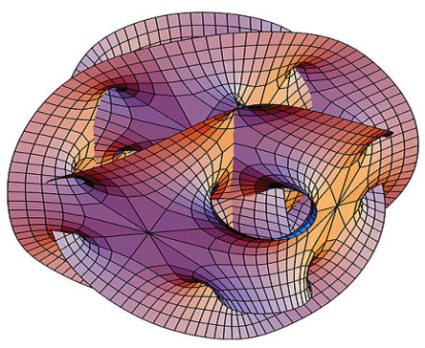
Concluding Remarks
The core of AI is machine learning.
Machine learning is executed through deep neutral networks.
Each step of the tasks accomplished by deep neutral networks involves statistics.
Statistics can promote the function of AI, whereas AI can also facilitate development of statistics, especially computational statistics.
Currently used statistics is too simple to capture the complexity of big data.
We have pushed forward to shift statistics
From linear to nonlinear regression
From static modeling to dynamic modeling
From significance tests to mechanistic exploration
From partially informative networks to fully informative networks
From a simple data analysis to interdisciplinary cross-pollination
We are thinking about how to integrate statistics with
Yau-Yau nonlinear filter
Yau’s computational conformal geometry
Calabi-Yau manifolds

Slide 42
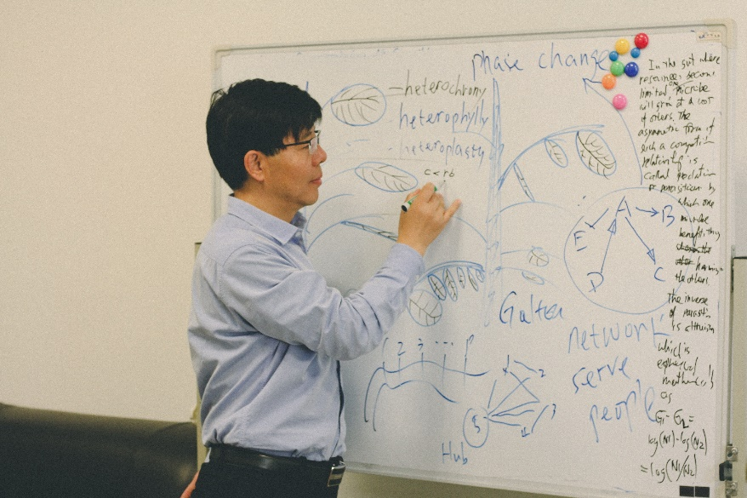

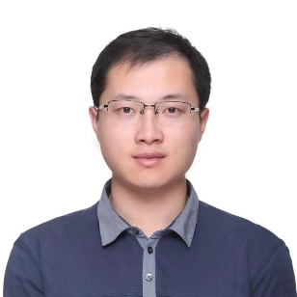
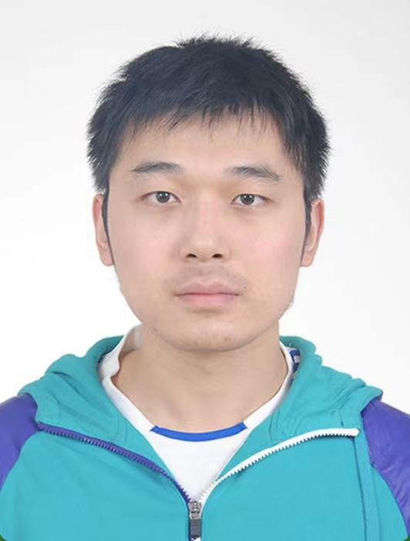

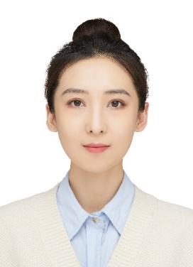
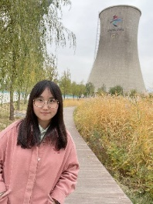

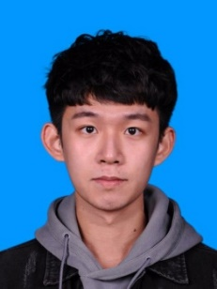
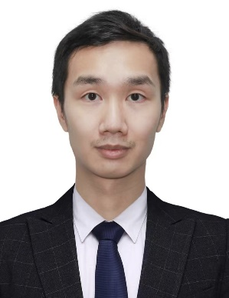



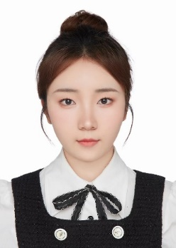






Research Program in Topological Statistics
BIMSA
YMSC
SIMIS
Statistics Mathematics

Slide 43


Supported by Yau Center at Tsinghua Univ. & CAS
Thank You!

